Slide 1
Course Objectives Module 1 – Splunk Deployment Planning ▪ Define the responsibilities of a Splunk Architect ▪ Introduce the Splunk deployment planning process and tools ▪ Identify the information that is needed for deployment decisions ▪ Provide lists and resources to aid in collecting requirements ▪ Review the network topology for Buttercup Games

Slide 2
About This Course
This course focuses on architects, consultants and administrators responsible for large Splunk Enterprise deployments. Students learn steps and best practices for planning, data collection and sizing for a variety of distributed environments. Workshop-style labs challenge students to make design decisions about an example enterprise deployment.

Slide 3
Course Objectives Module 1 – Splunk Deployment Planning ▪ Define the responsibilities of a Splunk Architect ▪ Introduce the Splunk deployment planning process and tools ▪ Identify the information that is needed for deployment decisions ▪ Provide lists and resources to aid in collecting requirements ▪ Review the network topology for Buttercup Games

Slide 4
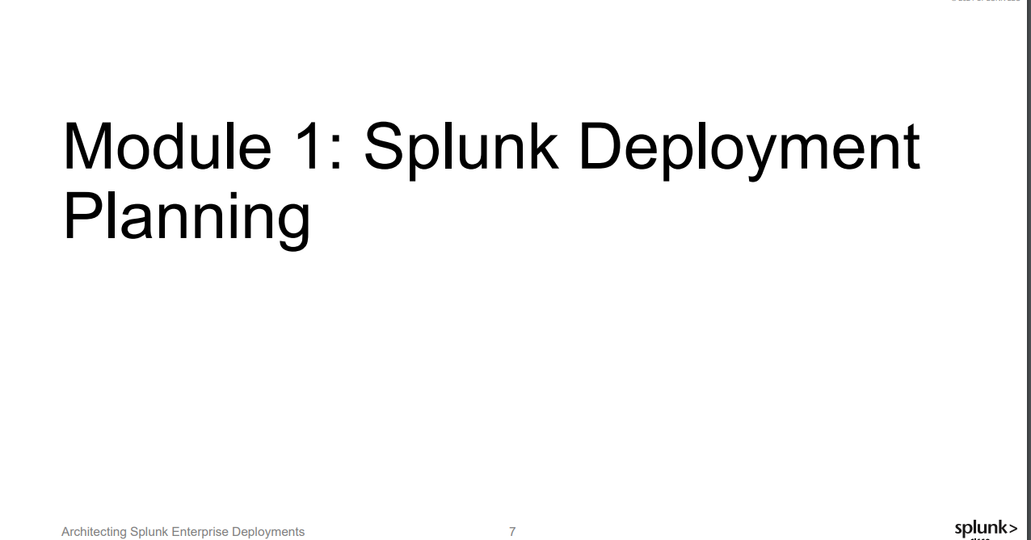

Slide 5
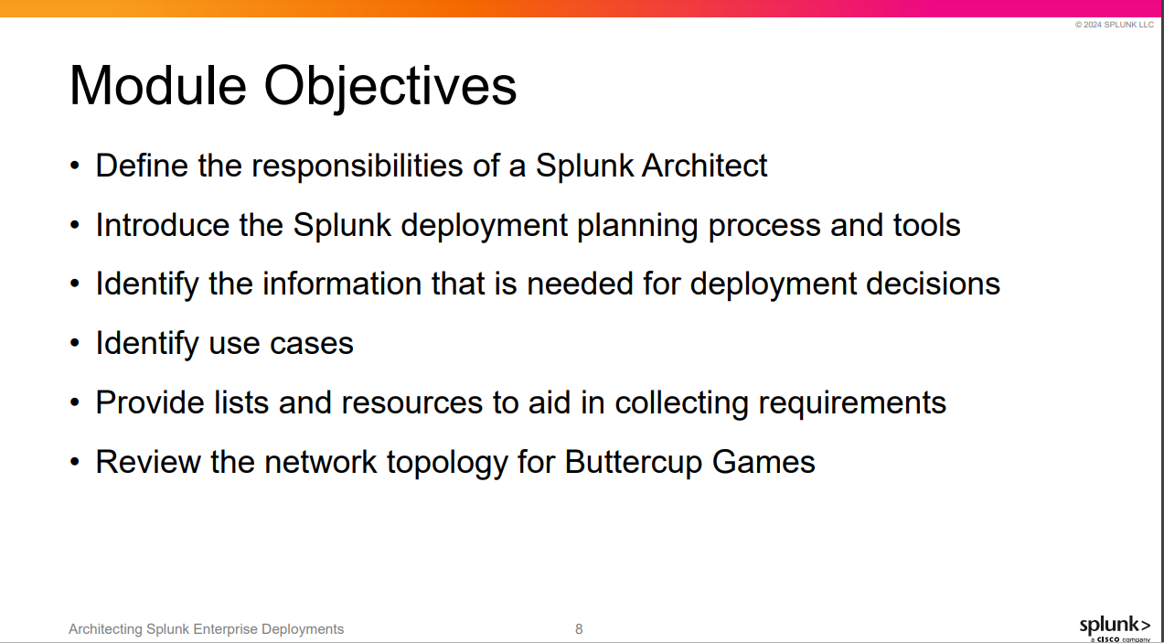

Slide 6
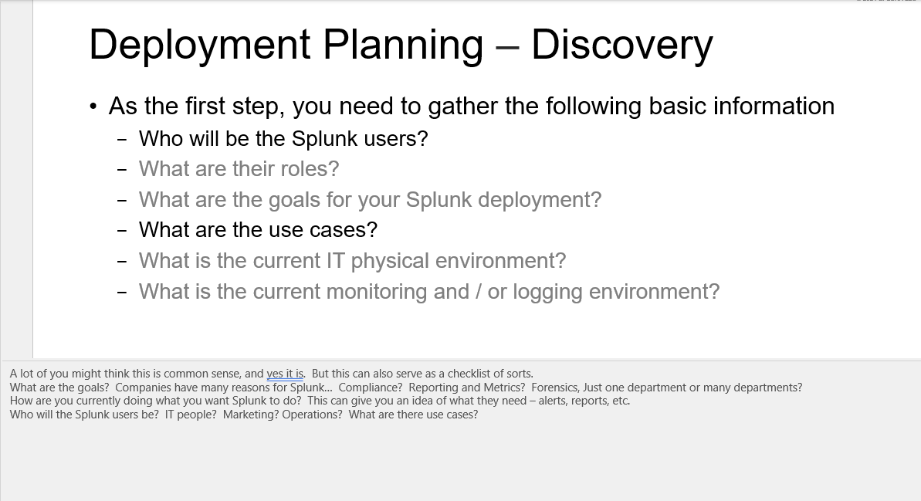

Slide 7
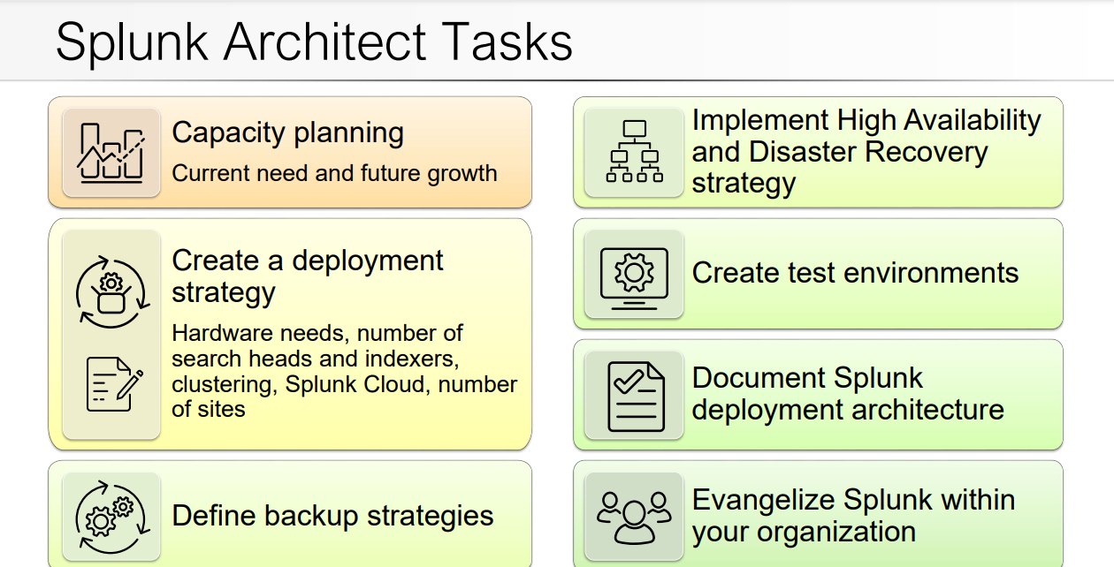

Slide 8
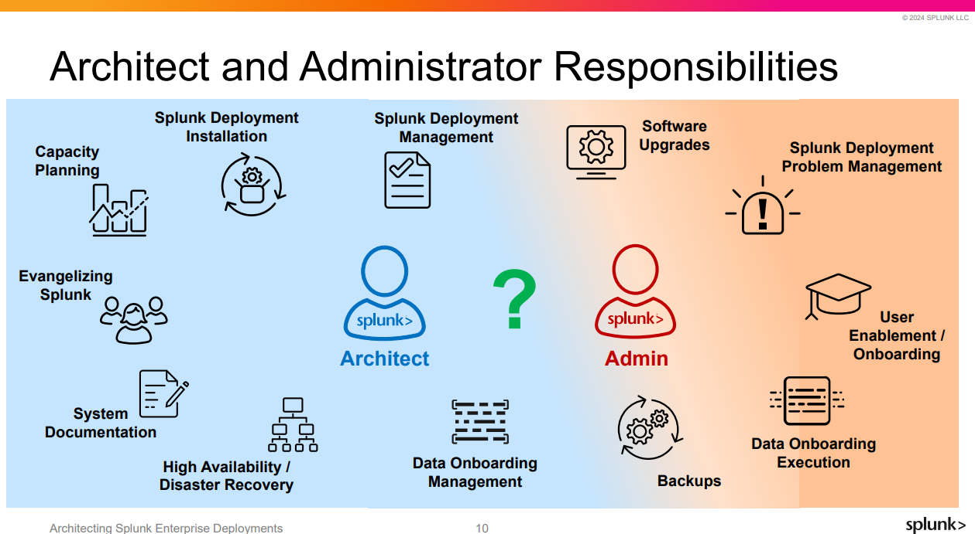

Slide 9
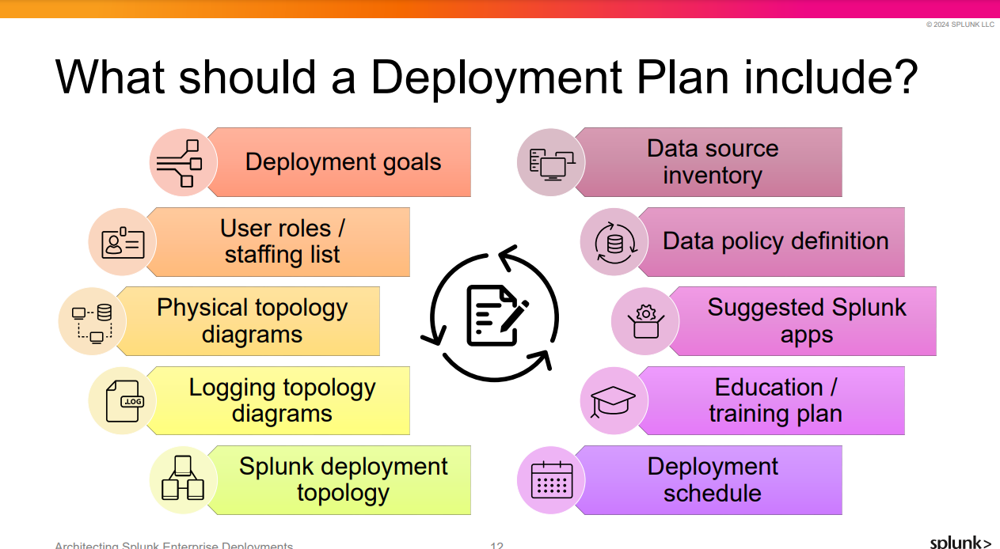
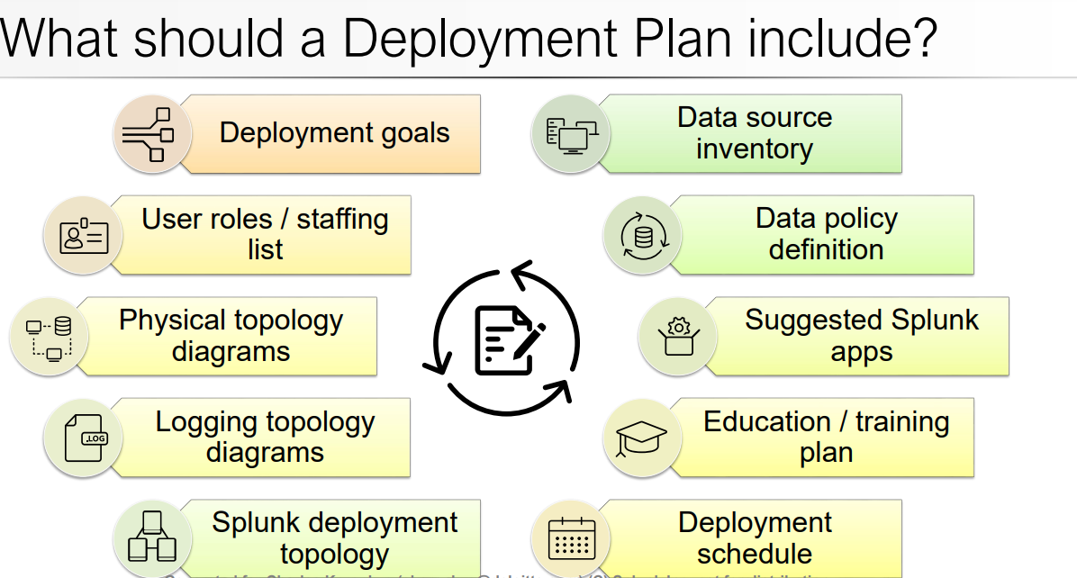

Slide 10
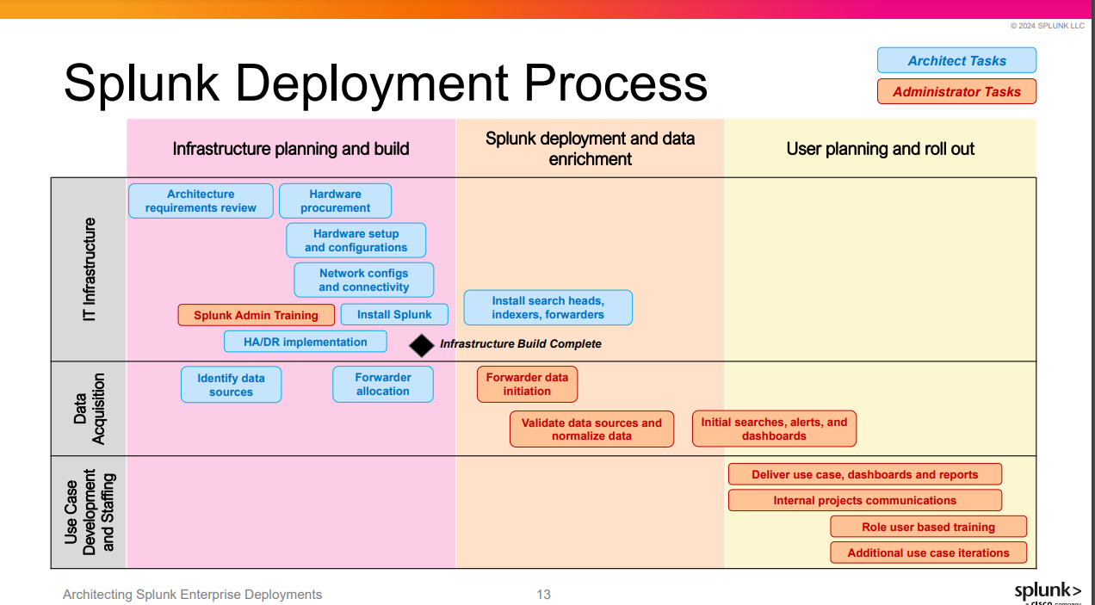

Slide 11
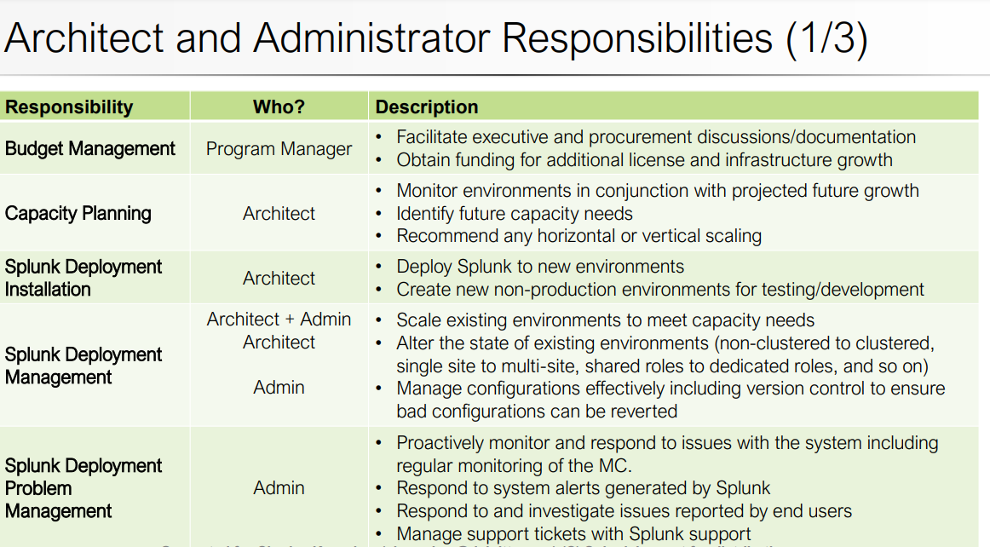

Slide 12
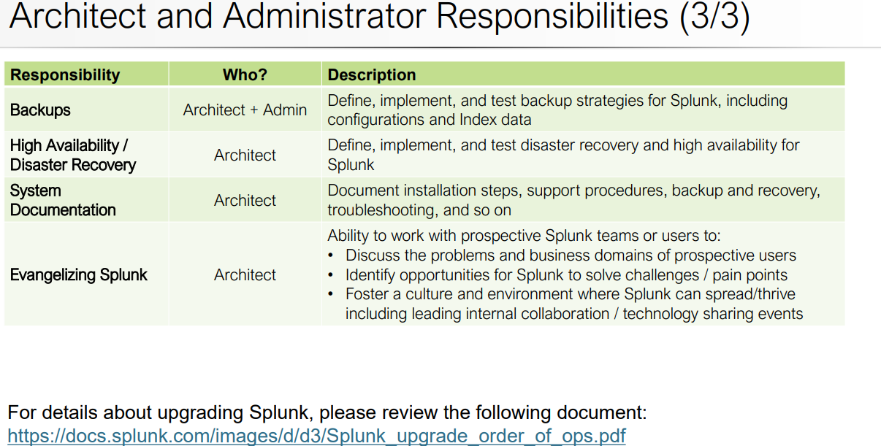

Slide 13
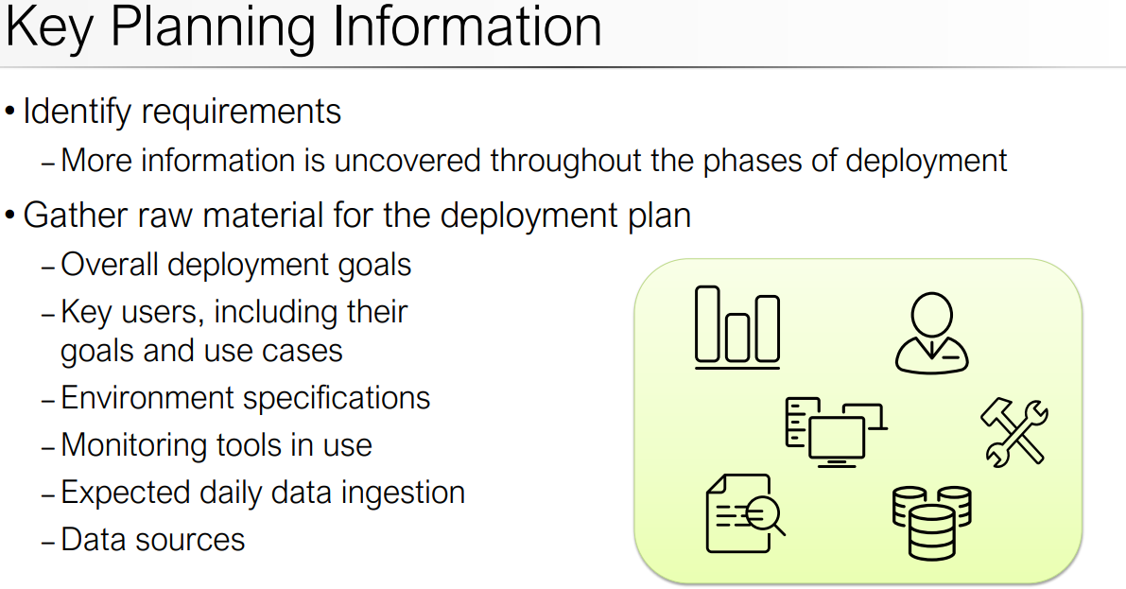
Module 2: Project Requirements

Slide 14
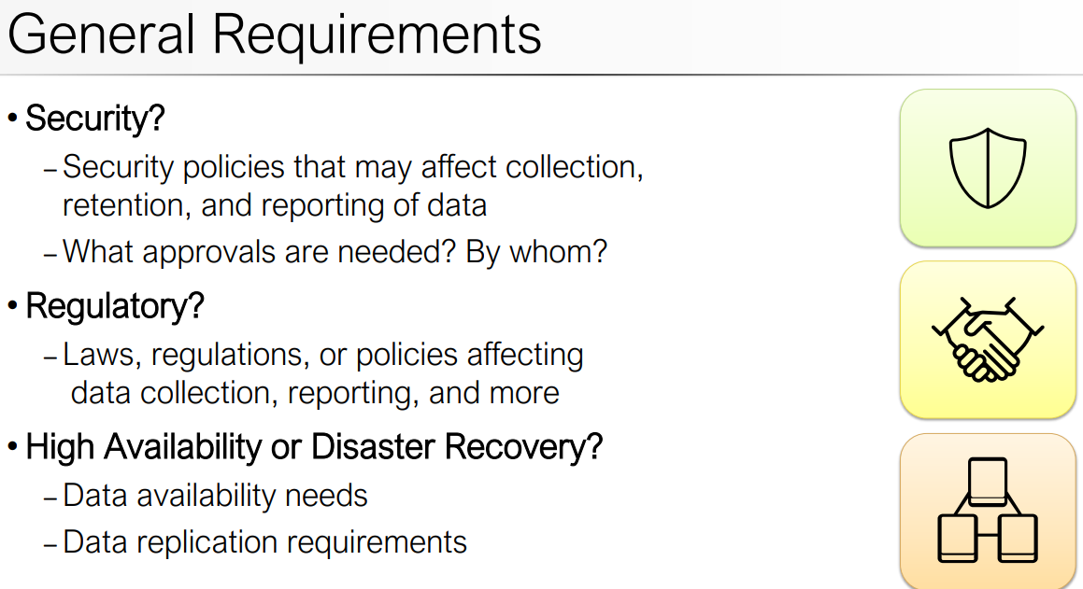
Module 2: Project Requirements

Slide 15
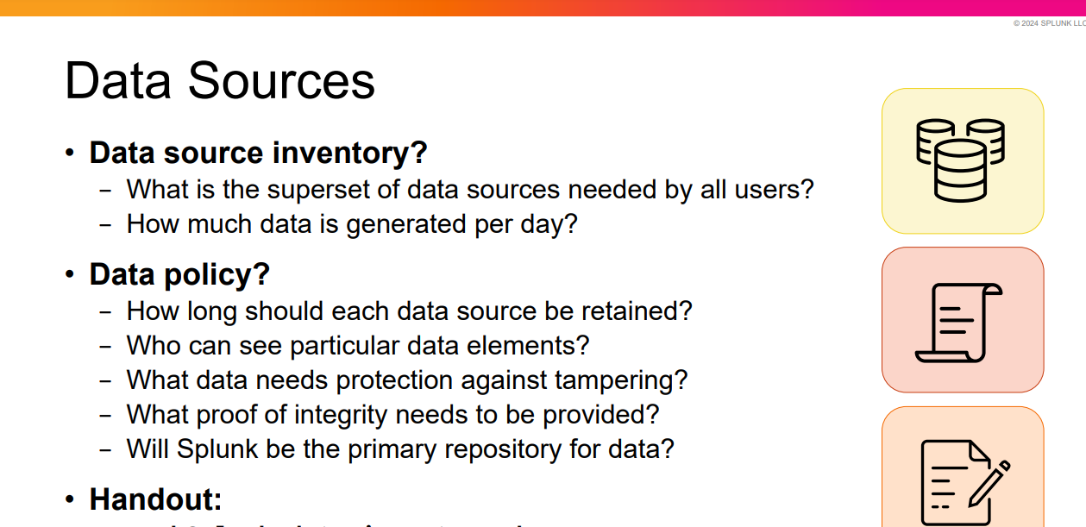

Slide 16
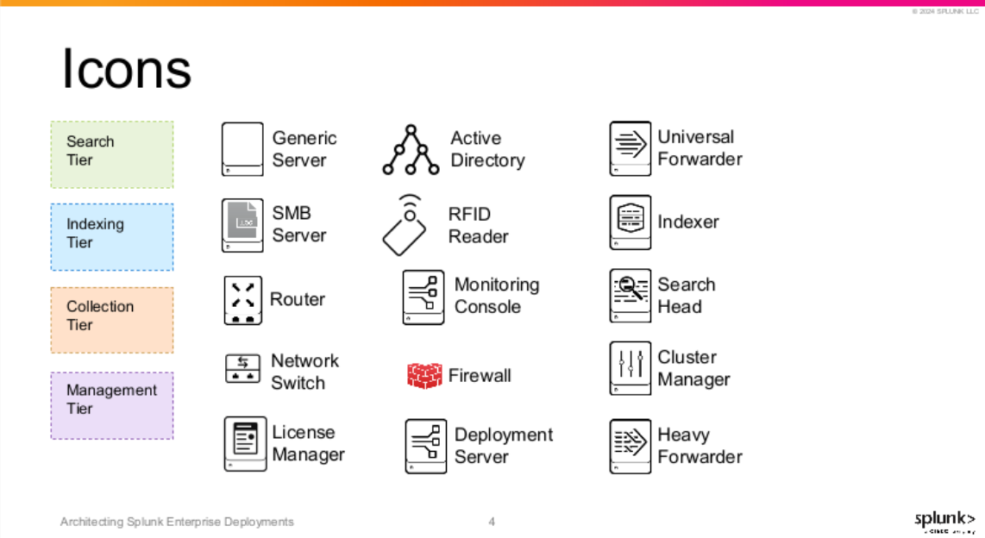

Slide 17
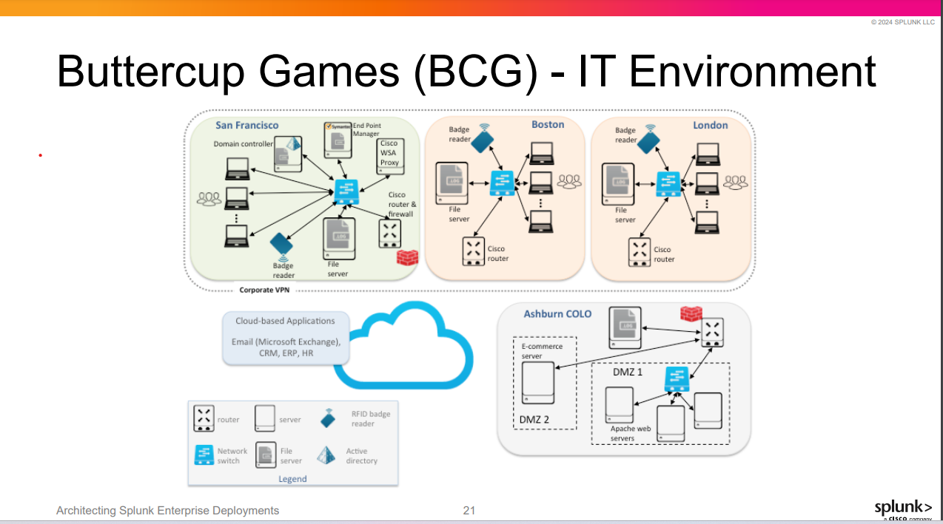

Slide 18
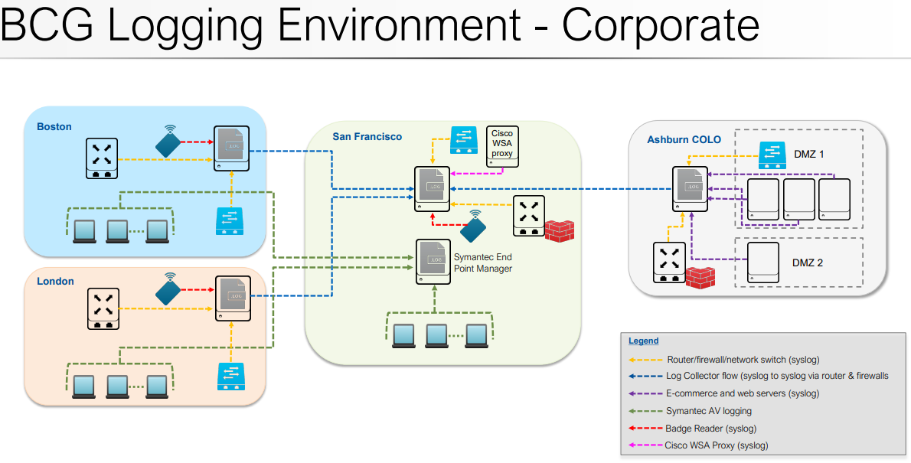

Slide 19
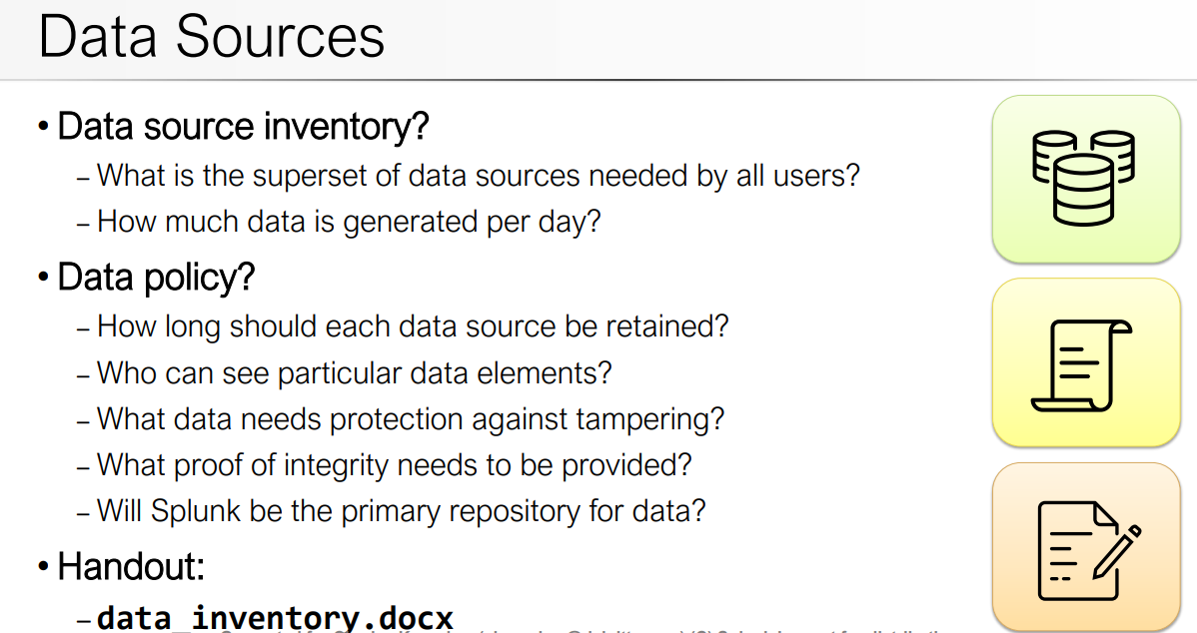
Module 2: Project Requirements

Slide 20
Module 2: Infrastructure Planning: Resource Planning

Slide 21
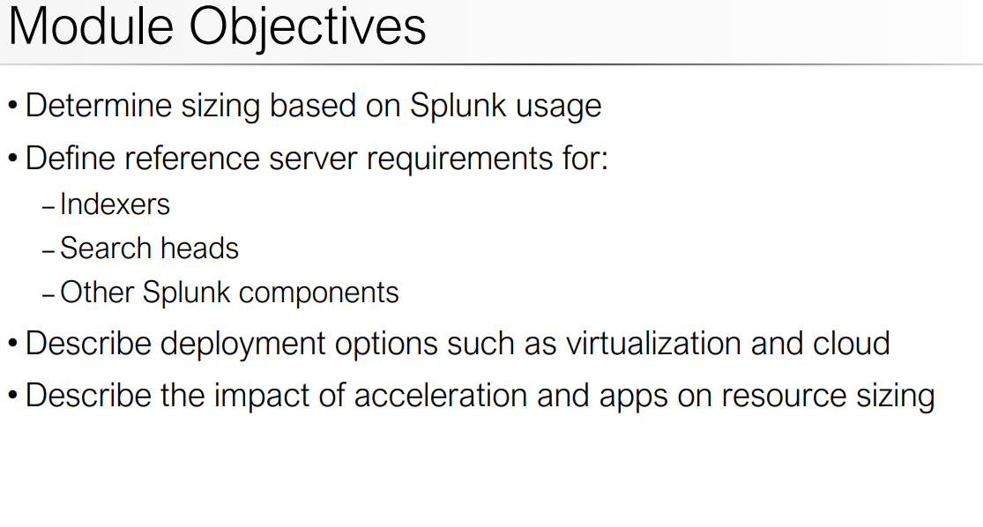
Module 2: Project Requirements

Slide 22
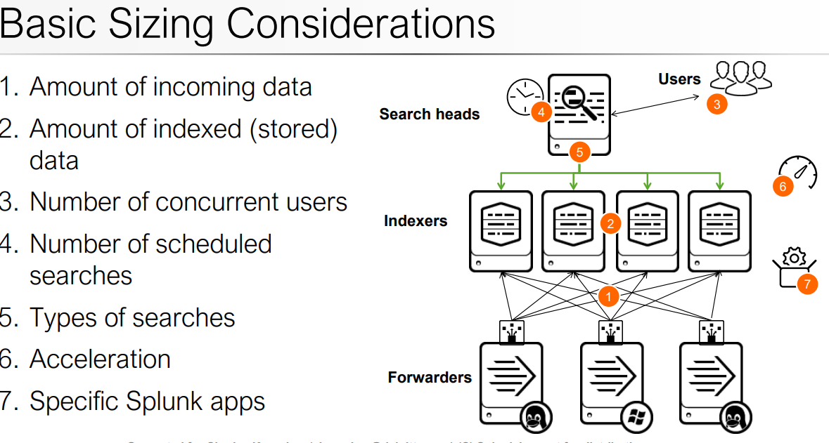
Module 2: Project Requirements

Slide 23
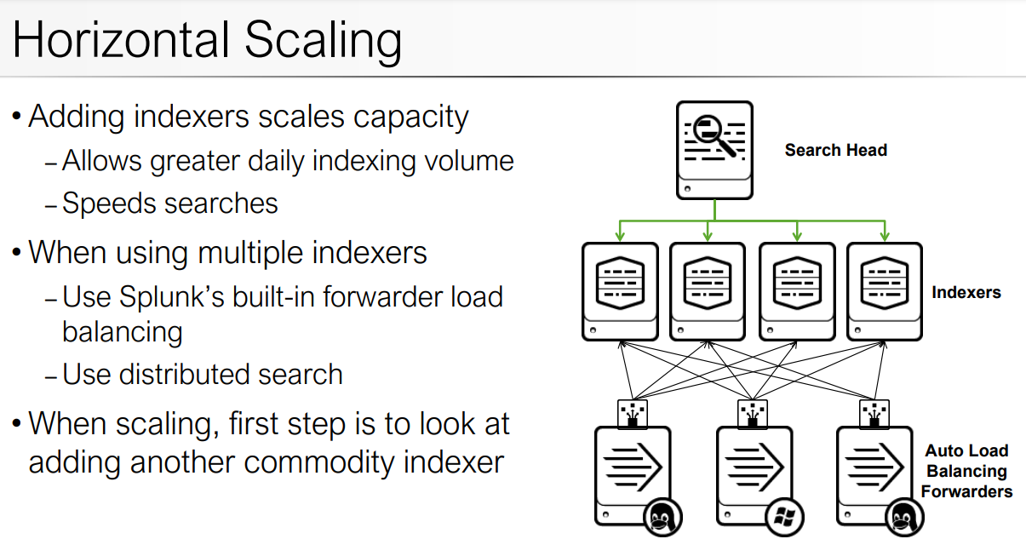
Module 2: Project Requirements

Slide 24
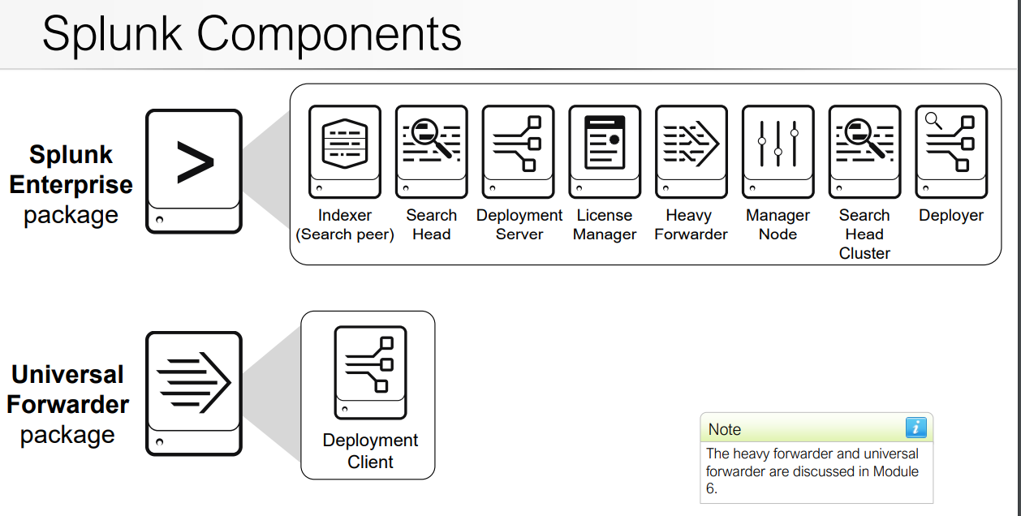
Module 2: Project Requirements

Slide 25
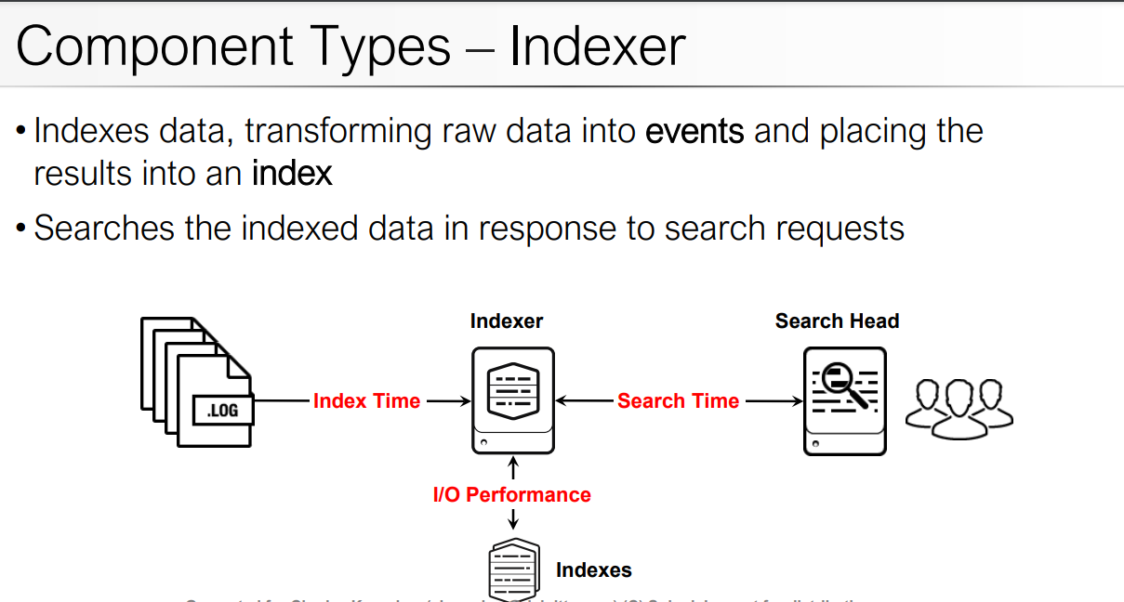
Module 2: Project Requirements

Slide 26
Manage pipeline sets for index parallelization
Index parallelization is a feature that allows an indexer to maintain multiple pipeline sets. A pipeline set handles the processing of data from ingestion of raw data, through event processing, to writing the events to disk. A pipeline set is one instance of the processing pipeline described in How indexing works. It is called a "pipeline set" because it comprises the individual pipelines, such as the parsing pipeline and the indexing pipeline, that together constitute the overall processing pipeline

Slide 27
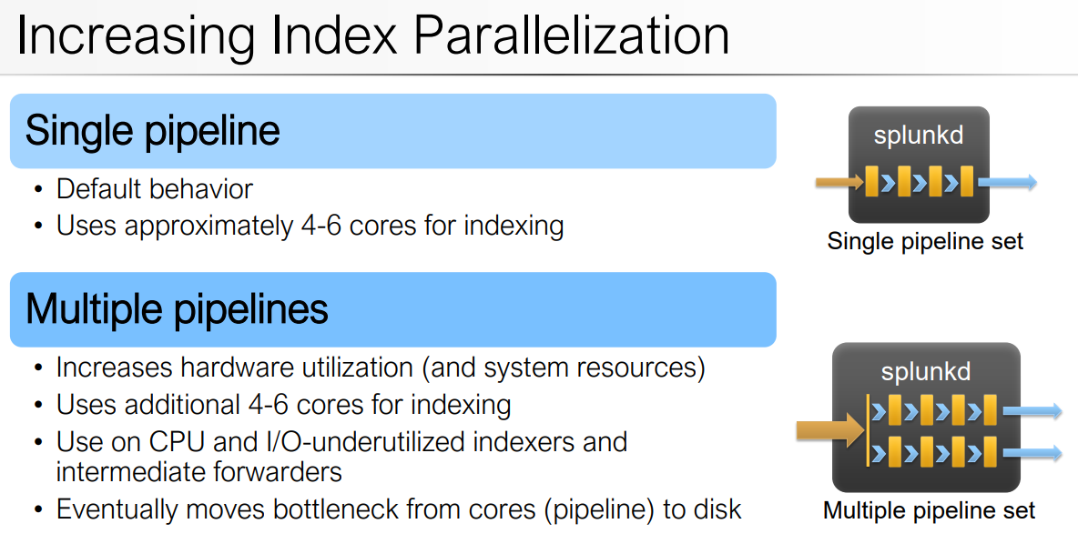
Module 2: Project Requirements

Slide 28
Module 2: Project Requirements

Slide 29
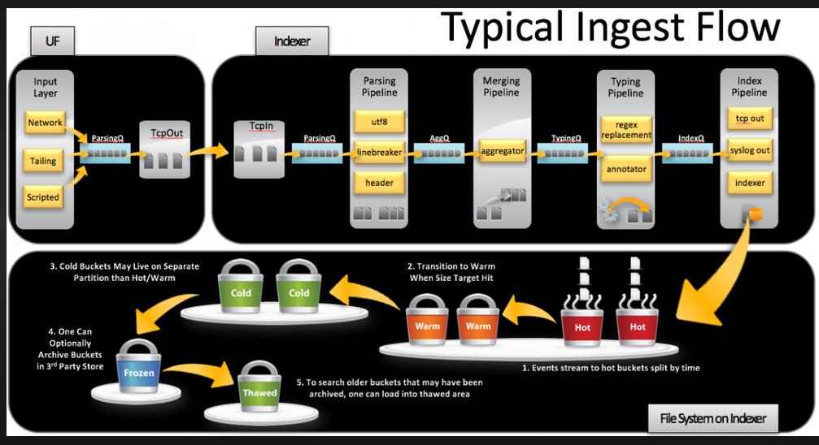
Module 2: Project Requirements

Slide 30
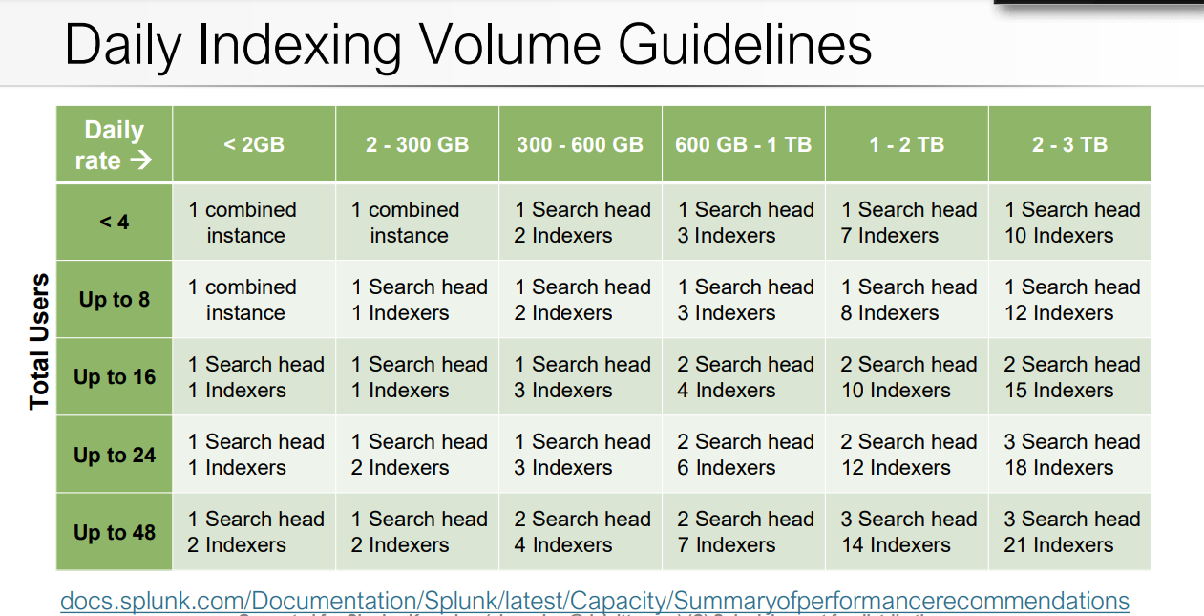
Module 2: Project Requirements

Slide 31
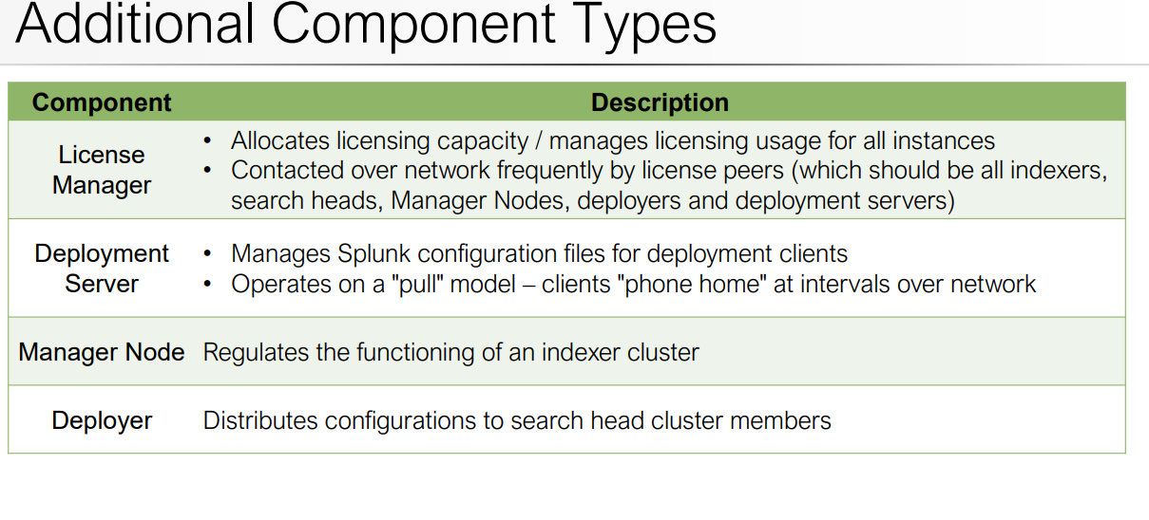
Module 2: Project Requirements

Slide 32
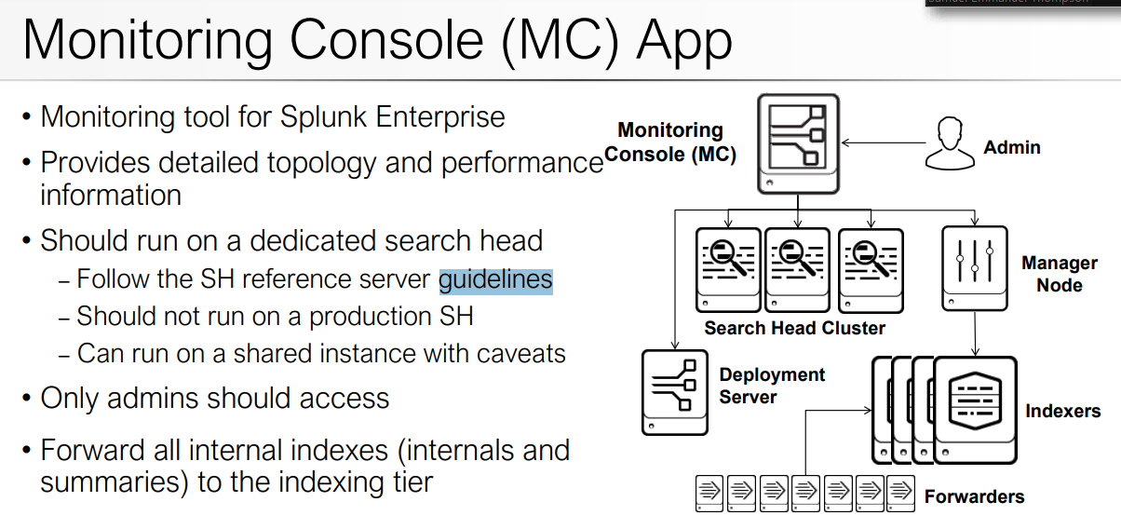
Module 2: Project Requirements

Slide 33
Module 4: Clustering Overview

Slide 34
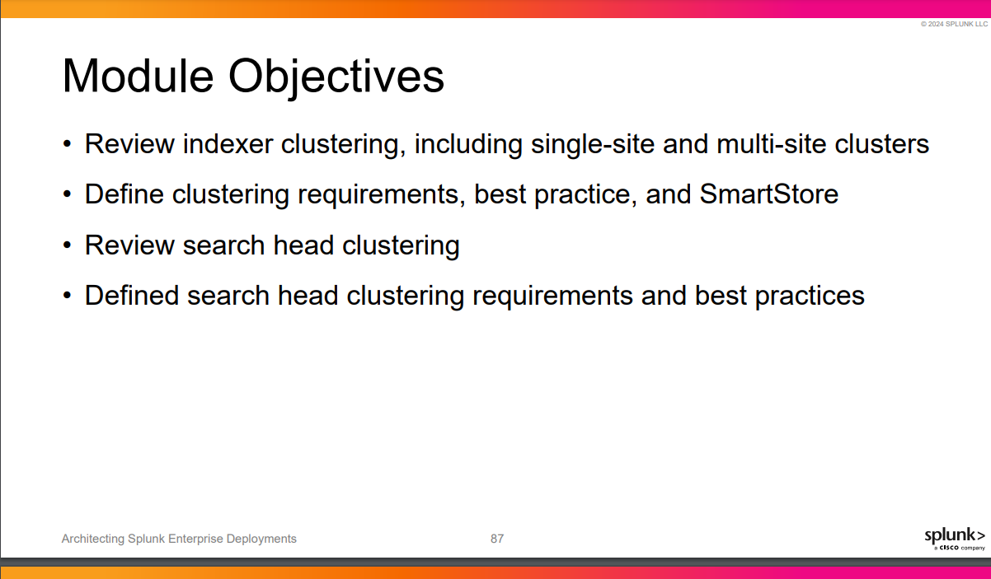
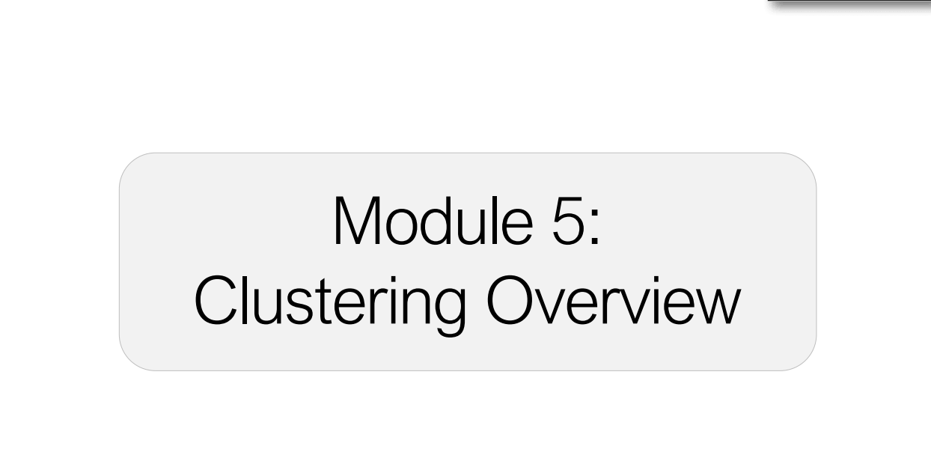
Module 2: Project Requirements
Module 5: Clustering Overview
Module 5: Clusterin Overview

Slide 35
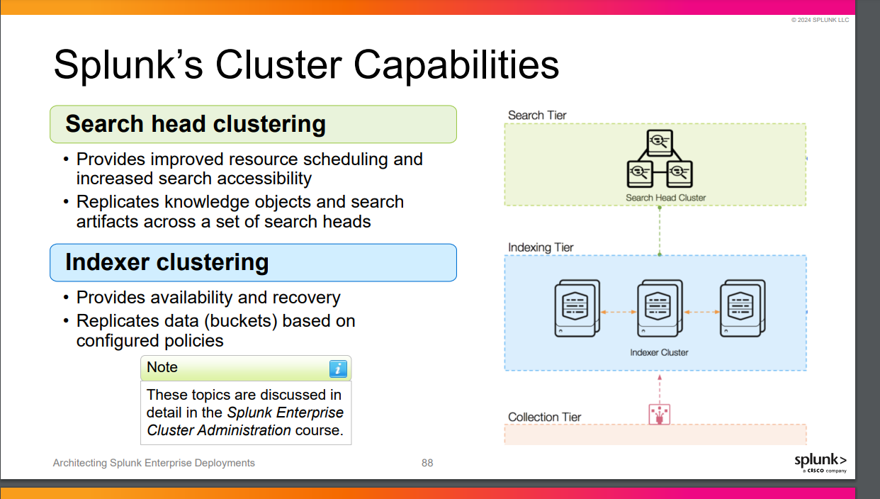
Module 2: Project Requirements
Module 5: Clustering Overview
Module 5: Clustering Overview

Slide 36
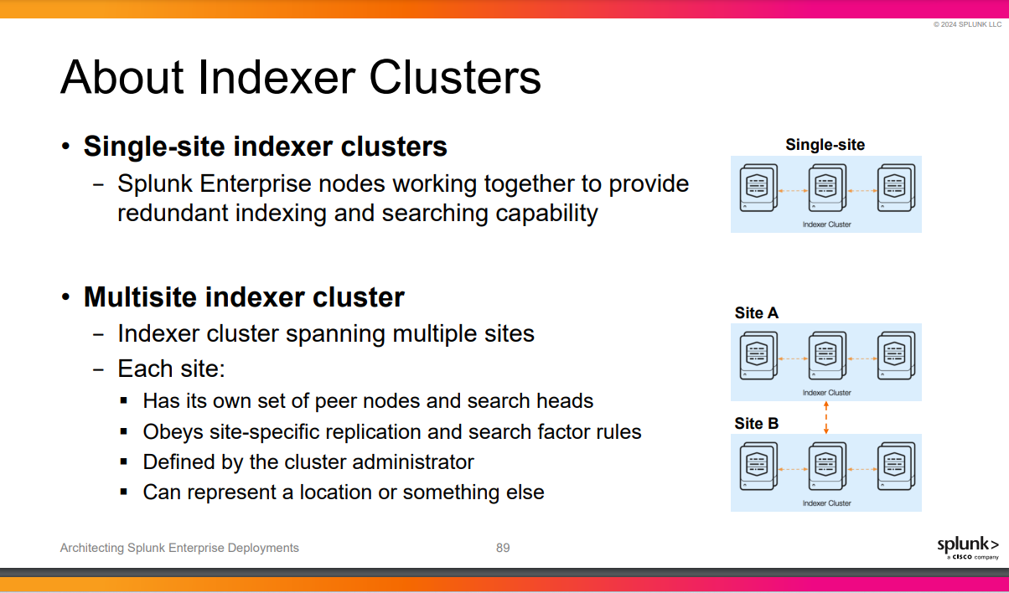
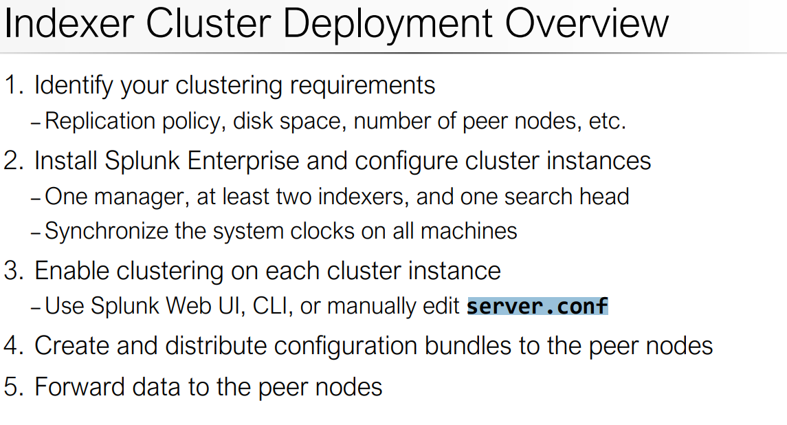
Module 2: Project Requirements
Module 5: Clustering Overview
Module 5: Clustering Overview

Slide 37
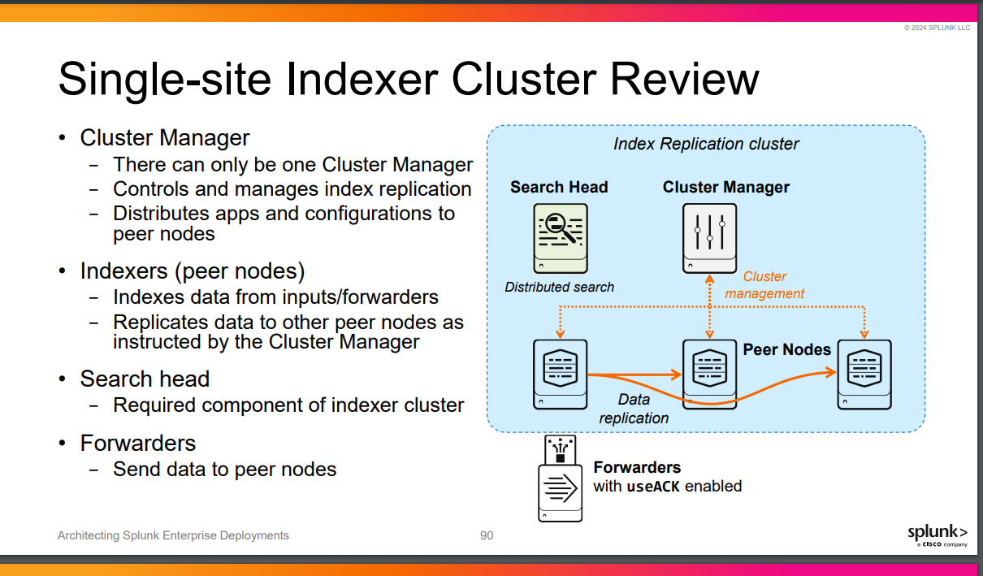
Module 2: Project Requirements
Module 5: Clustering Overview
Module 5: Clustering Overview

Slide 38
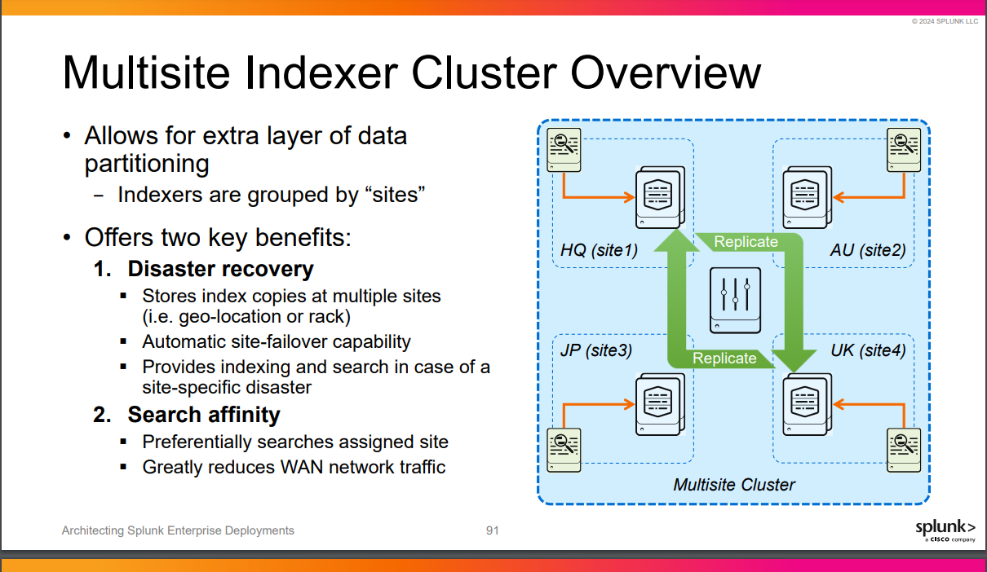
Module 2: Project Requirements
Module 5: Clustering Overview
Module 5: Clustering Overview

Slide 39
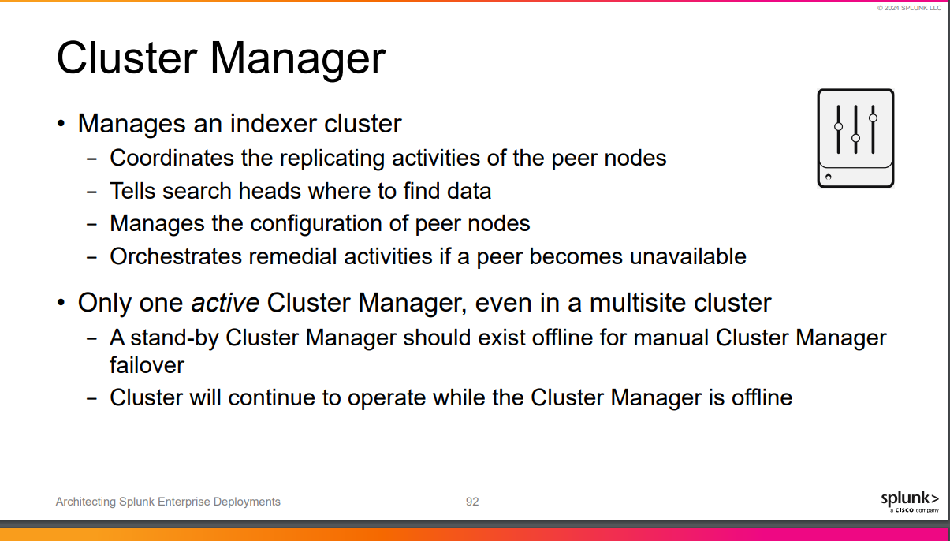
Module 2: Project Requirements
Module 5: Clustering Overview
Module 5: Clustering Overview

Slide 40
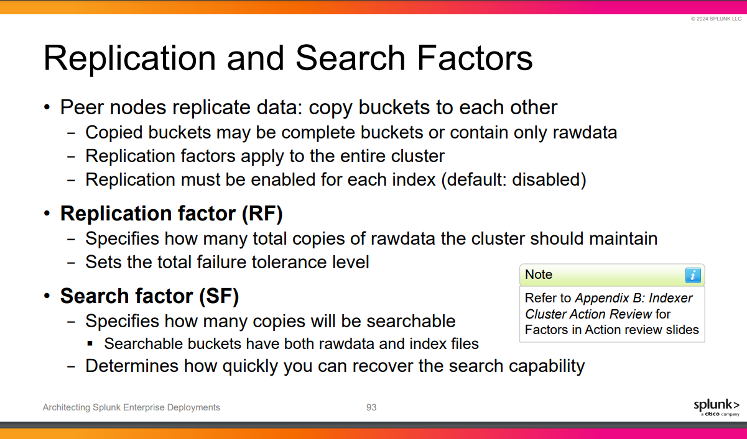
Module 2: Project Requirements
Module 5: Clustering Overview
Module 5: Clustering Overview

Slide 41
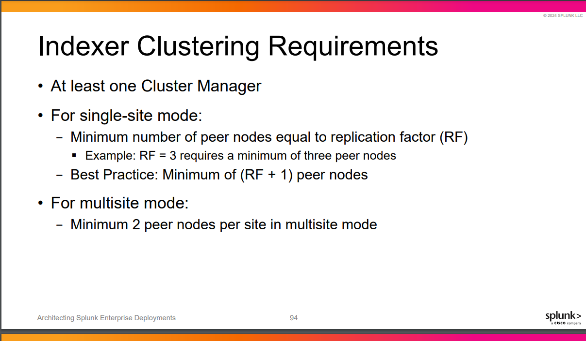
Module 2: Project Requirements
Module 5: Clustering Overview
Module 5: Clustering Overview

Slide 42
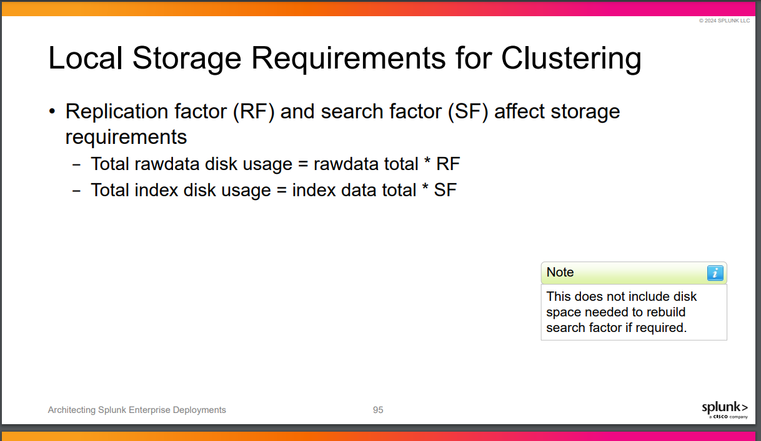
Module 2: Project Requirements
Module 5: Clustering Overview
Module 5: Clustering Overview

Slide 43
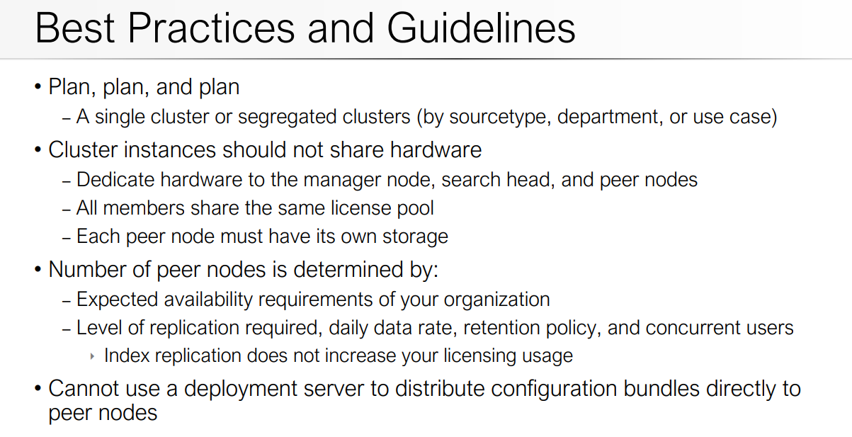

Slide 44
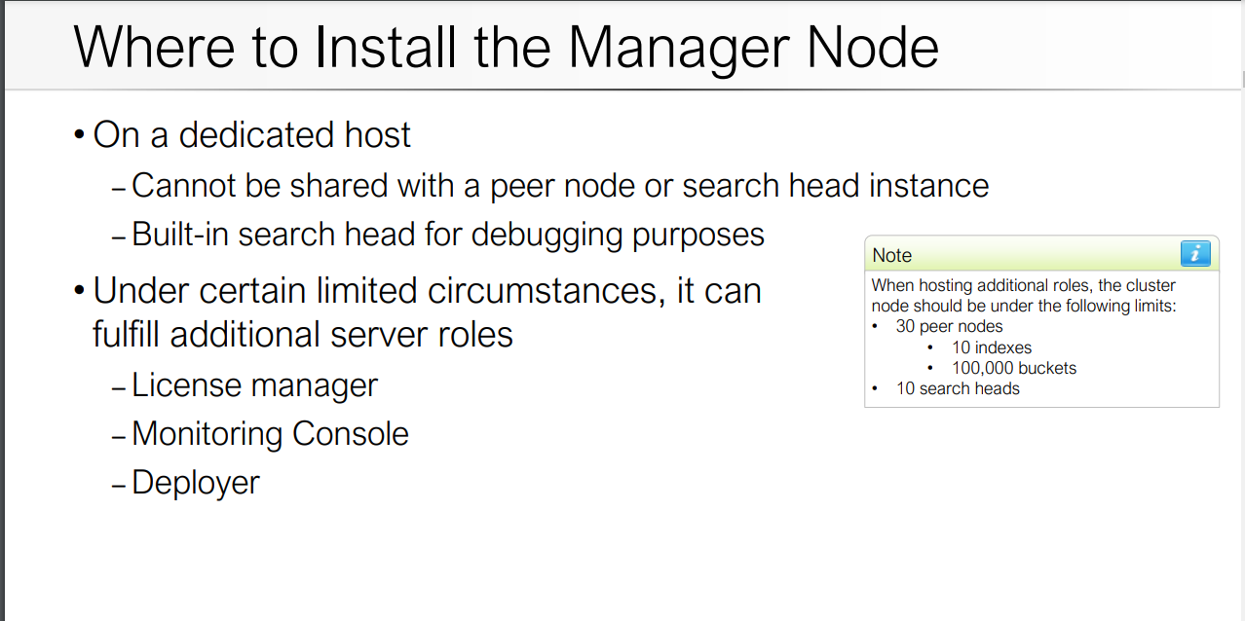
Module 2: Project Requirements

Slide 45
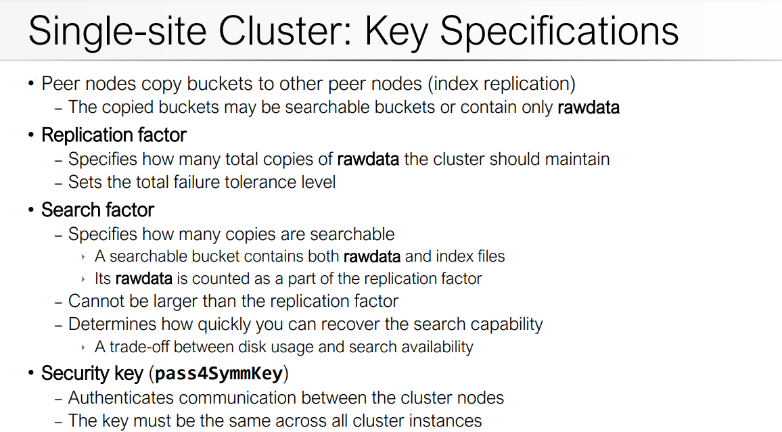
Module 2: Project Requirements

Slide 46
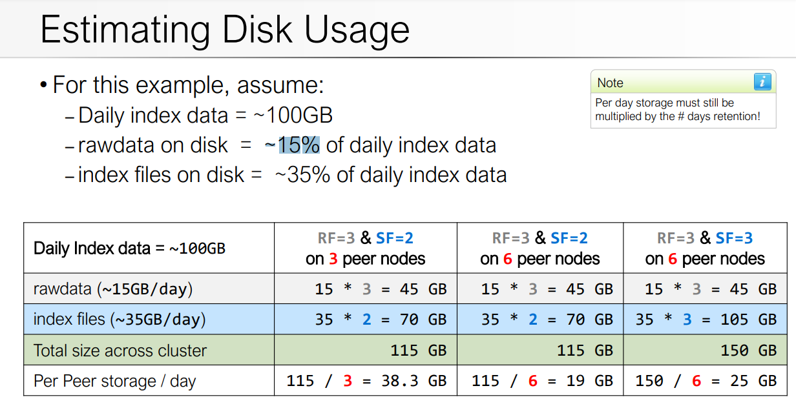
Module 2: Project Requirements

Slide 47
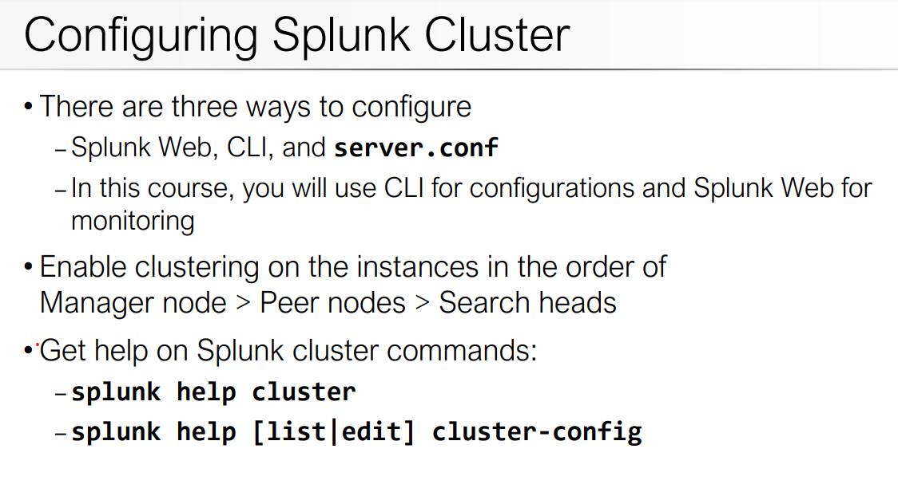
Module 2: Project Requirements

Slide 48
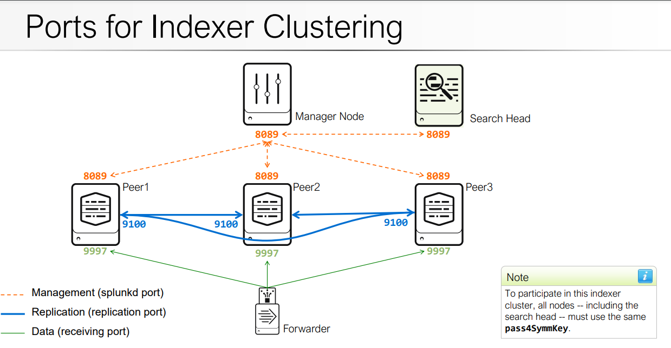
Module 2: Project Requirements

Slide 49
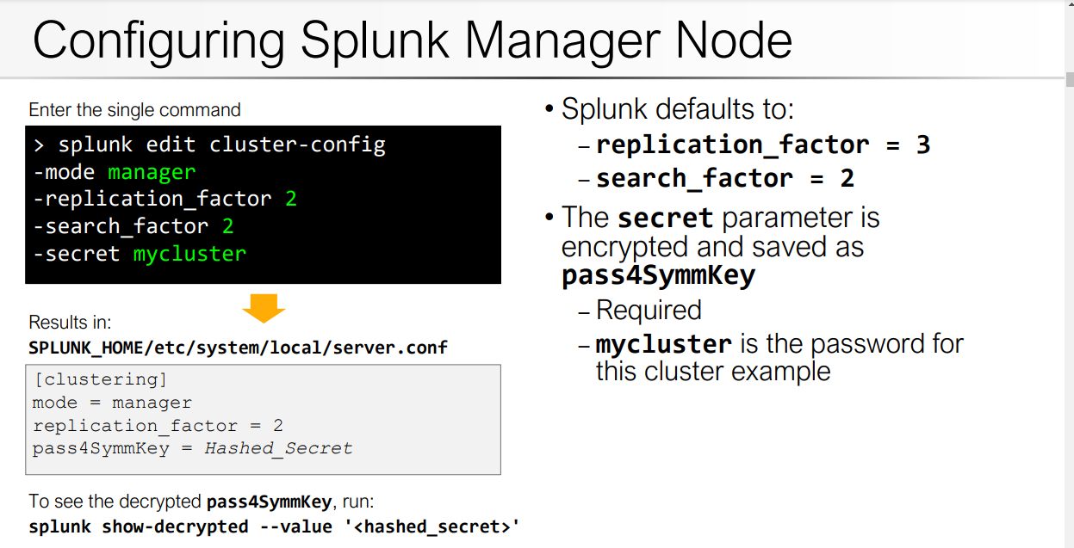
Module 2: Project Requirements

Slide 50
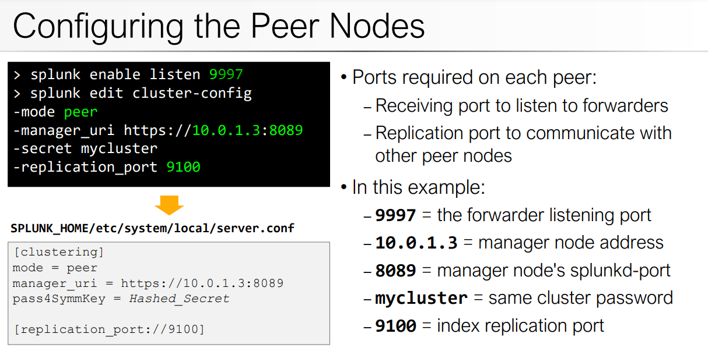
Module 2: Project Requirements

Slide 51

Module 2: Project Requirements

Slide 52
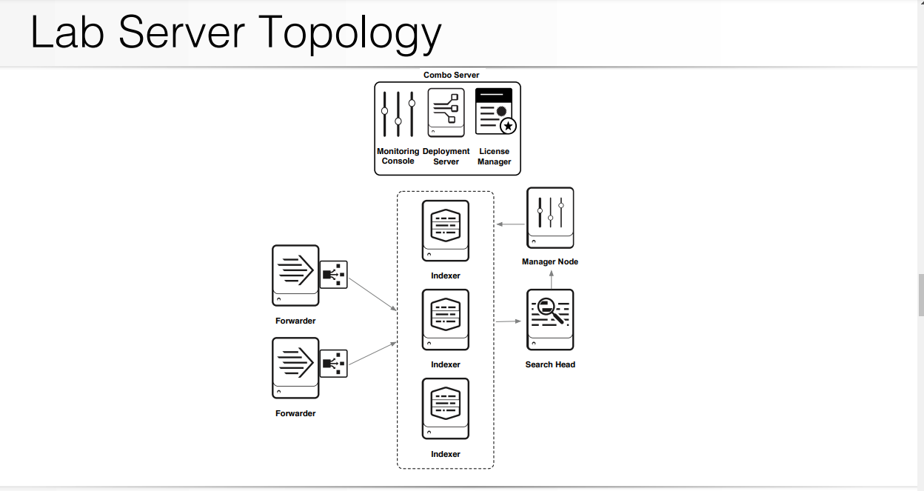
Splunk Enterprise Deployment Practical Lab

Slide 53
Phase 1 – Installation
Tasks
A. Install the Deployment Server / License Master / Monitoring
B. Install the forwarders
C. Install the Master Node and indexers
D. Install the Search Head
E. Forward internal logs to the Indexers
F. Configure the Monitoring Console

Slide 54
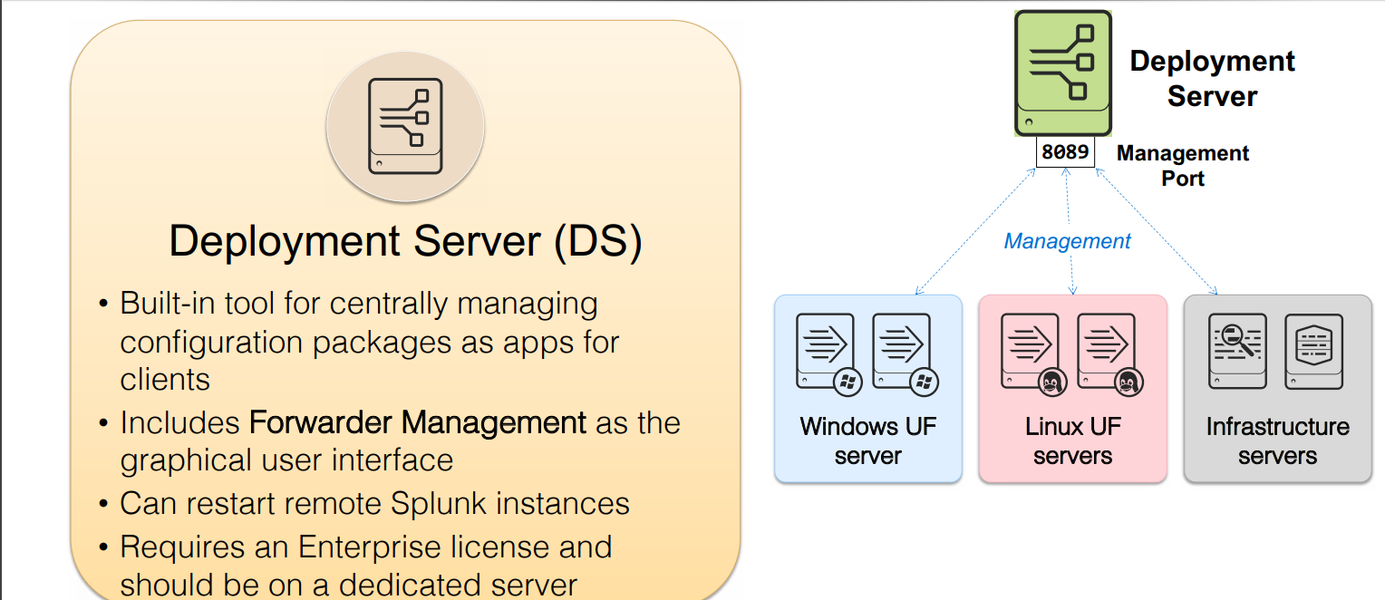
Module 2: Project Requirements

Slide 55
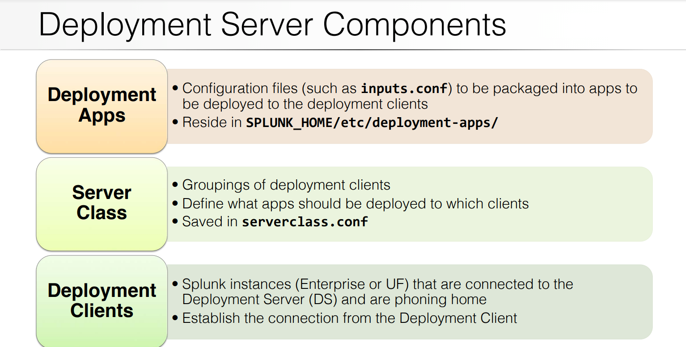
Module 2: Project Requirements

Slide 56
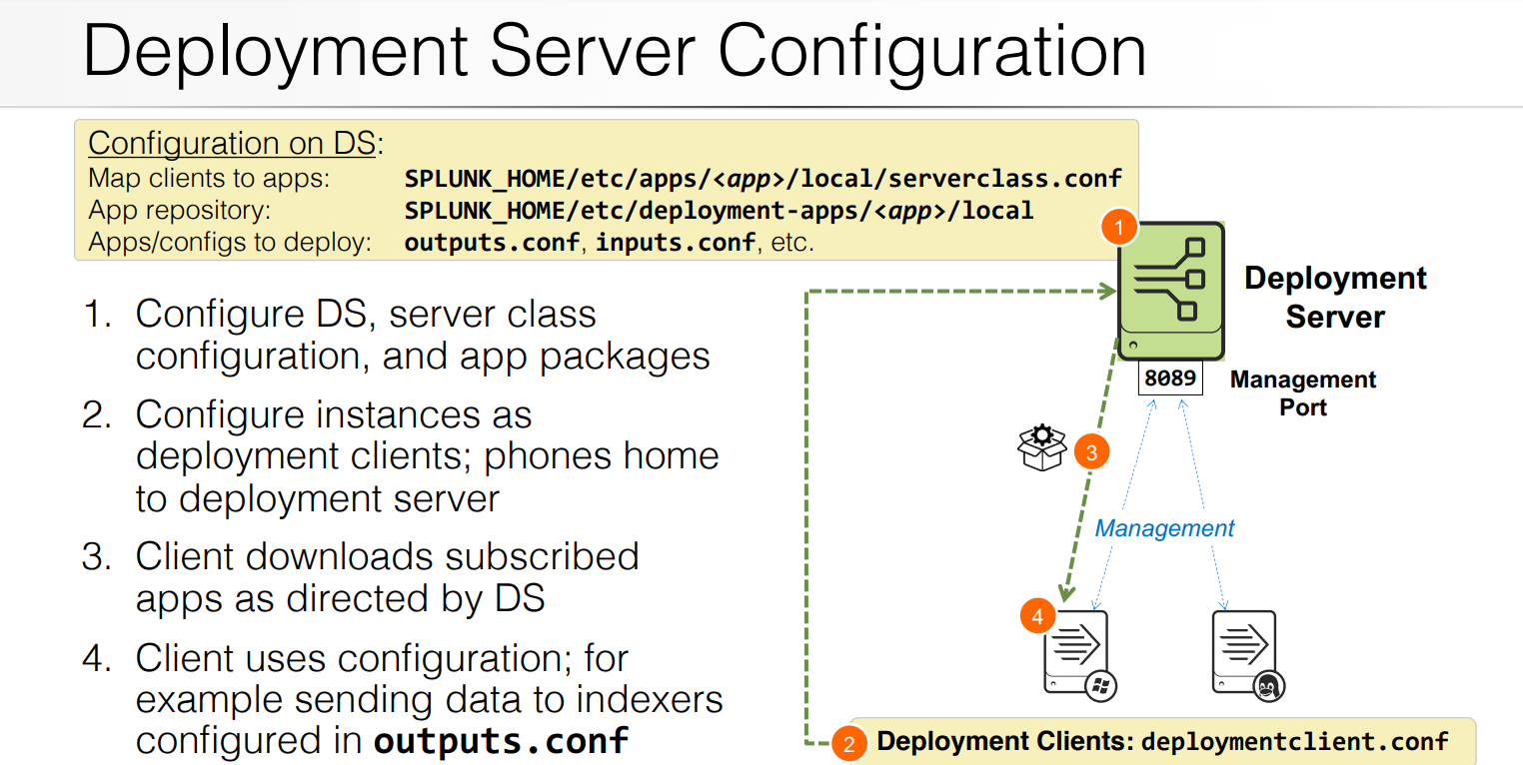
Module 2: Project Requirements

Slide 57

Module 2: Project Requirements

Slide 58

Module 2: Project Requirements

Slide 59

Module 2: Project Requirements

Slide 60

Module 2: Project Requirements

Slide 61

Module 2: Project Requirements

Slide 62

Module 2: Project Requirements

Slide 63

Module 2: Project Requirements

Slide 64

Module 2: Project Requirements

Slide 65

Module 2: Project Requirements

Slide 66
Module 2: Project Requirements

Slide 67
Module 2: Project Requirements

Slide 68
Module 2: Project Requirements

Slide 69
Module 2: Project Requirements

